Slide 1
3D Digital Image Correlation
Presented by
Qi Yiru
Notes:
Good afternoon, Prof Qian and Prof Tan! My project topic is to do the implementation realizing 3D digital image correlation.

Slide 2
Overview
Concepts and Theories
Algorithms and OpenCV
Implementation Process
Live Demo
Future Work
Q&A
Notes:
Today I’ll first briefly talk about the concepts and theories applied in the image correlation process, and then since I’m using the OpenCV library to do the implementation, I’ll introduce you some of the important models and algorithms used in OpenCV. After that, I’ll talk about different parts of the project and steps of the implementation process. Then I’ll give you a demo of the projects, followed by possible future work.

Slide 3
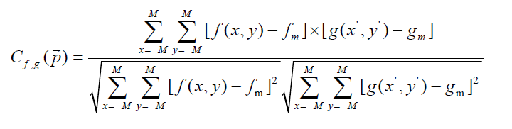
Concepts and Theories
2D DIC
Notes:
About the concept of digital image correlation (DIC), we should start with 2D DIC. It is often used to find the displacement of certain points on an object surface after some deformation. Like what is shown in this diagram, the original image is compared with the deformed image by a correlation function, so the corresponding target subimage can be found for any specified subimage. For example, if we are using the standardized correlation function, we’ll take the reference subimage, and compare with a subset in the target image by substituting the intensity values into the correlation function. After that, we define the target subimage as the subset maximising the correlation function value, because larger value indicates that the subimages are more similar to each other.

Slide 4
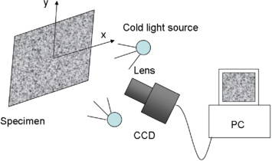
Concepts and Theories
Setup for 2D DIC
Notes:
The setup and implementation of 2D DIC is relatively simple. We only need sample images before and after the deformation, one camera, and the implementation of the correlation function, which is already available in many language libraries and tools, such as MatLab and OpenCV etc. However there are some limitations of 2D DIC method. It requires that the object surface is planar and smooth, and it cannot detect the depth displacement, so in order to detect the depth information, we need 3D DIC.

Slide 5
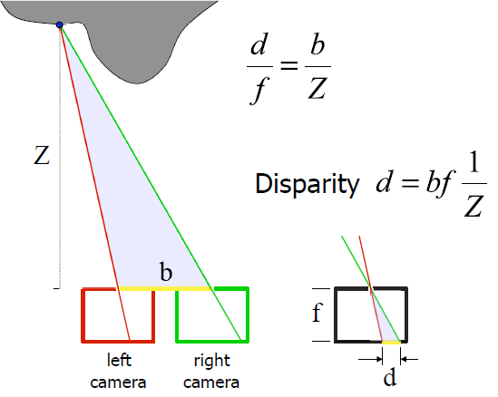
Concepts and Theories
3D DIC Stereo Geometry
Notes:
This concept is mainly based on the stereo geometry model, which is shown in the diagram. So we need two cameras instead of one, and we take pictures from left and right cameras, and observe the disparity between object points from left and right images. If we take closer look at this diagram, Z is the distance from the camera to the object, which is also the depth information we want to obtain, b is the baseline of the two cameras, which is the distance between the optical centers of the two cameras, and f is the focal length, d is the disparity. If we overlap the image planes within the two cameras, we get the small diagram, and we can find the pair of similar triangles in the diagrams. Therefore, we have the relationship of the depth Z and disparity d represented in this equation. This means that, as long as we can find the disparity between the images, we can get the depth information accordingly. Then the other steps will be the same as 2D DIC.

Slide 6
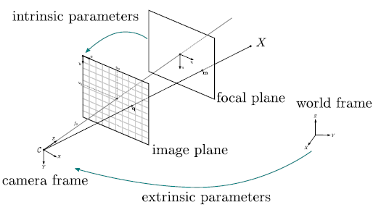
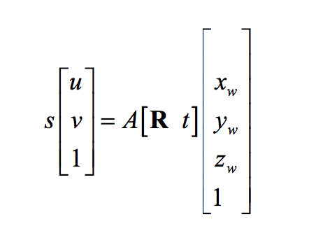
Concepts and Theories
Pinhole Camera Model
Notes:
So the main task of 3D DIC is to find the 3D coordinates of each object point from the 2D image plane. In this process, we apply the pinhole camera model. We assume that the cameras are without lens, and the aperture is a small pinhole that allows light going through and projecting an inversed object on the image plane. As shown in the diagram, the extrinsic parameters capture the transformation of the object from world coordinates to camera coordinates. This includes the rotation and translation matrices of the camera. And the intrinsic parameters capture the transformation from the camera frame to the image plane. This includes the focal length and optical center positions. This model can be represented by the equation given here. The distortion coefficients should also be considered when calculating the parameters. This is usually done by substituting the coefficients into the image coordinates as parameters too. Once we get some image to world coordinates pairs, we can calculate the parameters and store them, and they can be applied to any image points to get the 3D coodinates.

Slide 7
Algorithm and OpenCV
Advantages of OpenCV
Better performance
Portability
Experience with C++
Notes:
So this is our main task, and there are available functions in order to complete this task provided by open source libraries like OpenCV and MatLab. I chose to utilise OpenCV library mainly because of these 3 reasons. Firstly, MatLab is interpreted language, which makes it quite slow, if I use OpenCV with C++, the performance would be much better. Secondly, it is very possible that this software would be moved to other platforms to be used, improved and maintained. OpenCV with C++ is highly portable among platforms, while MatLab can only run on very limited platforms. The last reason is that I have used C++ in a course project previously, so I can save some time learning the language syntax. So next, I’ll introduce you some of the key algorithms used in the implementation with OpenCV.

Slide 8

Algorithm and OpenCV
Camera Model in OpenCV
Notes:
The models used in OpenCV was mainly adopted from the method introduced by Mr Zhang from Microsoft. This is the pinhole camera model used in OpenCV. It is almost the same as the original one, except that the skewness parameter is always 0 in this model, that is the second number in the first row of matrix A. This is a safe assumption if recent digital cameras are exploited.

Slide 9
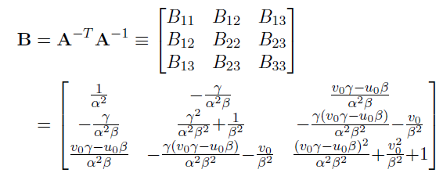





Algorithm and OpenCV
Obtain Intrinsic Parameters by Matrix B
Intrinsic Constraints
Notes:
Zhang newly defined a matrix B, which encapsulates all the intrinsic parameters. Therefore, as long as we get matrix B, we get all the intrinsic parameters. Since B is symmetric, it can be defined as a vector with 6 elements, and we can substitute it into the intrinsic constraints shown in the equations. The resulted expression can be solved by a stack of homographies of left and right images.

Slide 10


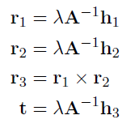

Algorithm and OpenCV
Solve the Model Using Homography Matrix
Notes:
So what is homography? It is defined as the combination of camera matrix and extrinsic matrices, which is the whole transformation from world coordinates to image coordinates. This can be obtained by finding the image coordinates of some specified object points in the world coordinates, which is the process of camera calibration. After we get the intrinsic parameters, the extrinsic parameters are easily obtained by the equations shown here. Note that r3 is omitted initially because during calibration, we assume that all the specified points in the world are on the same plane, which means Z equals to 0. And since r1 and r2 are orthogonal normal vectors, we can get r3 simply from the cross product of r1 and r2 later.

Slide 11
Algorithm and OpenCV
Optimisation Using Levenberg-Marquardt Algorithm
Parameter estimation
Re-projection error estimation
Notes:
When estimating the parameters, the Levenberg-Marquardt algorithm is used to set the threshold of estimations. It uses gradient to find local minimum, and is the most popular least squares method. It is also used to estimate the reprojection error. That is the variance from the original image coordinates to the reprojected image coordinates, which is from the world coordinates calculated.

Slide 12
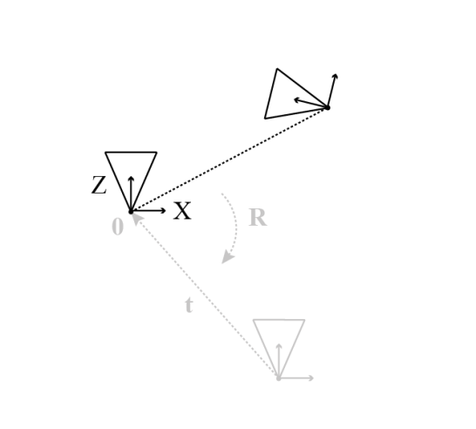
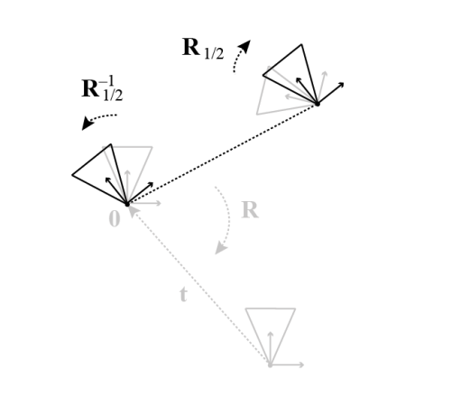
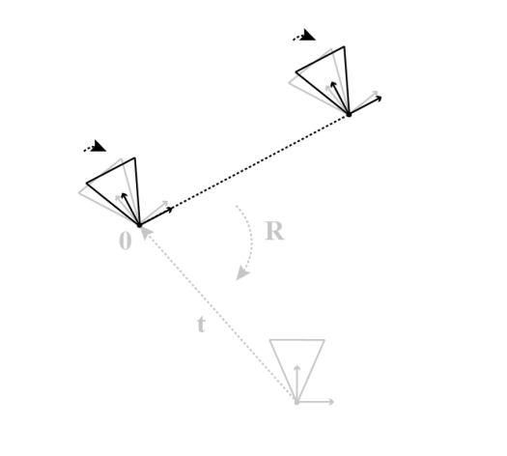
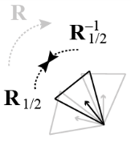
Algorithm and OpenCV
Rectification Using Bouguet’s Method
Notes:
So once we get the intrinsic and extrinsic parameters for the cameras respectively, we need to do the stereo correspondence of the left and right images in order to find the disparities. This Bouguet’s method is used to rectify the cameras, so that the two cameras are aligned horizontally to each other, which makes the correspondence process easier. In this method, instead of aligning the cameras horizontally one by one, it aligns them to each other first, then apply the rotation to both of them to obtain the final rectified images.

Slide 13
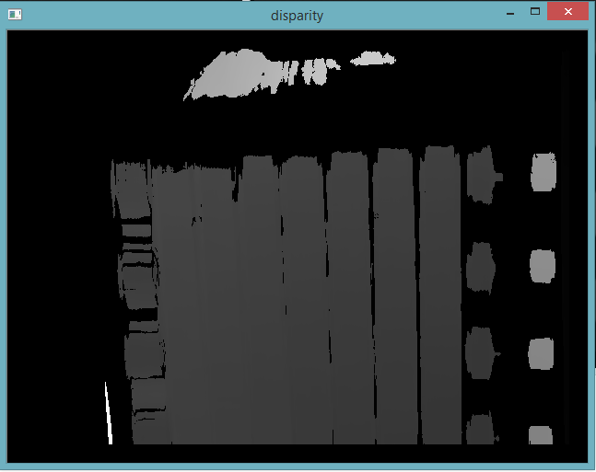
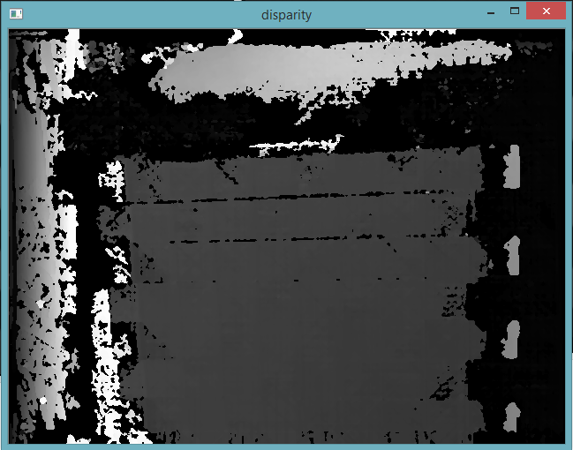
Algorithm and OpenCV
Block and Semi-global Block Matching
Notes:
After rectification, we can use block matching function to calculate the disparity map for the image pairs. There are two algorithms in order to achieve this. One is the block matching algorithm. For each pixel in the left image, the algorithm search through a specified range to find the most suitable disparity. Another one is semi-global block matching algorithm. This generates the more detailed disparity map. Researches show that the SGBM algorithm is better, but I tried and found that it generates inaccurate and noisy maps in my case, and it is slower, so I still used BM algorithm.

Slide 14


Algorithm and OpenCV
Re-projection Using Disparity-to-Depth Matrix Q
Notes:
So the last step is to transform the disparity into depth information. The matrix Q is defined for this purpose. The expression is derived from the stereo geometry introduced in the beginning of this presentation. So finally we can get the 3D coordinates of the object points.

Slide 15
Implementation Process
Camera Calibration
Stereo Correspondence
3D Reconstruction

Slide 16
Live Demo

Slide 17
Future Work
Experimental validation
3D Model Correlation
Integration and UI

Slide 18
Q&A

